Slide 1
MVC(Model View Controller)
MVC is a pattern for developing software applications which divide the representation of information from the user's interaction with it.
MVC are well architected, testable and easy to maintain.
Models:
Classes that represent the data of the application and that use validation logic to enforce business rules for that data.
It is the part of the application that handles the logic for the application data.
Often model objects retrieve data (and store data) from a database.

Slide 2
Contd…
Views:
A view display data(database record)that dynamically generate HTML responses.
Multiple views of the same data are possible.
It is the parts of the application that handles the display of the data.
Most often the views are created from the model data.
Controllers:
Classes that handle incoming browser requests(user interaction), retrieve model data, and then specify view templates that return a response to the browser.
Typically controllers read data from a view, control user input, and send input data to the model.

Slide 3
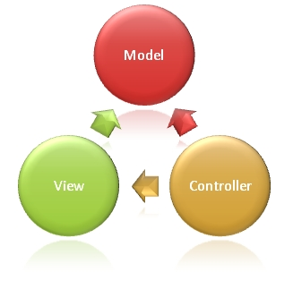

Slide 4
Client–server model
Client/server architecture is a computing model in which the server hosts, delivers and manages most of the resources and services to be consumed by the client.
This type of architecture has one or more client computers connected to a central server over a network or Internet connection.
This system shares computing resources.
Client/server architecture may also be referred to as a networking computing model because all the requests and services are delivered over a network.

Slide 5
Contd…
The model assigns one of two roles to the computers in a network:
A server is a computer system that selectively shares its resources;
a client is a computer or computer program that initiates contact with a server in order to make use of a resource.
Data, CPUs, printers, and data storage devices are some examples of resources.
Client-server architectures are sometimes called two-tier architectures.
Technology that separates computers and application software into two categories clients, and servers to better employ available computing resources and share data processing loads.

Slide 6
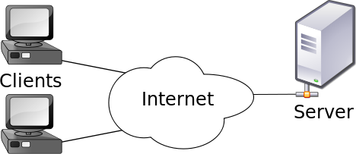

Slide 7
Tier and Layer
Tier usually means the physical deployment computer. Usually an individual running server is one tier.
Layer usually means logic software component group mainly by functionality;
layer is used for software development purpose.
Layer software implementation has many advantages and is a good way to achieve N-Tier architecture.
Each layer may run in an individual tier. However, multiple layers may also be able to run in one tier.

Slide 8
2-Tier Architecture
Either presentation layer and application layer can only run in one server,
or application layer and data layer can only run in one server
The whole application cannot run in more than 2 servers.
The client that runs the application and the server that handles the database back-end.
Server able to load many clients allowing more users to work on the system at the same time. 2-tier is also called thick client.

Slide 9
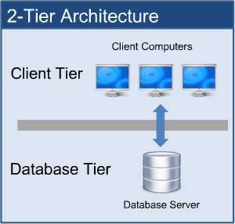

Slide 10
Contd…
Client directly interact with the server.
This type of architecture may have some security holes and performance problems.
Internet Explorer and Web Server works on two tier architecture.
Here security problems are resolved using Secure Socket Layer(SSL).
Advantages:
simple and fast for a lower number of users due to fewer processes and fewer tiers; low cost for hardware, network, maintenance and deployment due to less hardware and network bandwidth needed.

Slide 11
Contd…
Disadvantages:
It will have issues when the number of users gets big; has limitation to solve issues like security, scalability, fault tolerance because it can be deployed in only 1 or 2 server.

Slide 12
3-Tier Architecture
One more software sits in between client and server. This middle software is called middleware
Middleware are used to perform all the security checks and load balancing in case of heavy load.
A middleware takes all requests from the client and after doing required authentication it passes that request to the server

Slide 13

Contd…

Slide 14
Contd…
Presentation layer:
A layer that users can directly access , such as desktop UI, web page and etc.
Application layer:
This layer encapsulates the business logic (such as business rules and data validation), domain concept, data access logic and etc. Also called middle layer
Data layer:
the external data source to store the application data, such as database server. such as SQL server, Oracle, DB2, MySQL

Slide 15
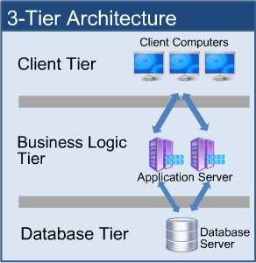

Slide 16
Comparisions of 2-tier and 3- tier
 | 2-Tier | 3-Tier
Benefits | Good security More scalable Faster execution | Exceptional securityFastest execution “Thin” client Very scalable
Issues | More costly More complex “Thick” client Less users | Very costly Very complex More users than 2 tier

Slide 17
N-Tier Architecture
Some layers in 3-Tier can be broken further into more layers. These broken layers may be able to run in more tiers.
application layer can be broken into business layer, persistence layer or more.
Presentation layer can be broken into client layer and client presenter layer.
Client presenter layer, business layer and data layer should be able to run in three separate computers (tiers).
Practically, all these layers can also be deployed in one server (tier).

Slide 18

Contd…

Slide 19
Contd…
Client layer:
It is directly involved with users. such as WPF, Window form, HTML web page and etc.
Client presenter layer:
It contains the presentation logic needed by clients, such as ASP .NET MVC in IIS web server. Also it adapts different clients to the business layer.
Business layer:
handles and encapsulates all of business domains and logics; also called domain layer.
Persistence layer:
handles the read/write of the business data to the data layer, also called data access layer (DAL).

Slide 20
Contd…
Data layer:
the external data source, such as a database.
Advantages
Scalable
Better and finer security control to the whole system
Better fault tolerance ability:
Independent tier upgrading and changing without affecting other tiers
Friendly for maintenance:
Better reusability

Slide 21
Contd…
Disadvantages
Much more complicated to design and model.
The performance of the whole application may be slow if the hardware and network bandwidth aren’t good enough because more networks, computers and processes are involved.
More cost for hardware, network, maintenance and deployment because more hardware and better network bandwidth are needed.

